Slide 1
From Output to Outcome
- Agile2018 Report -
Hiroyuki Ito

Slide 2
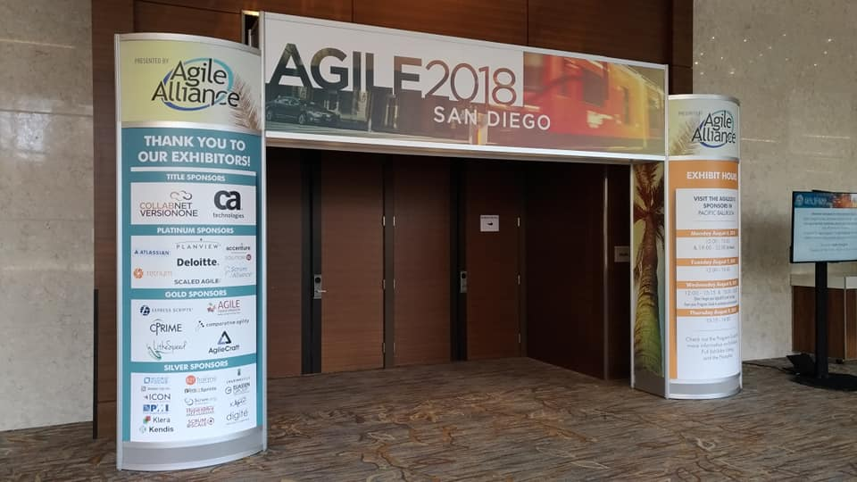
Open Your Gate

Slide 3
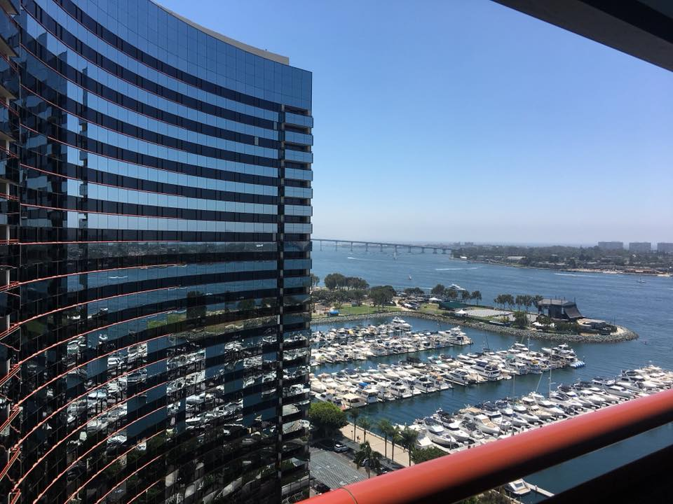


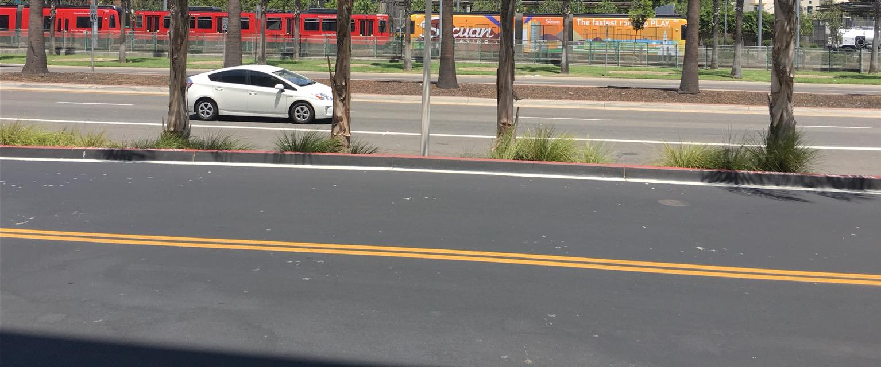
In San Diego, CA, USA

Slide 4
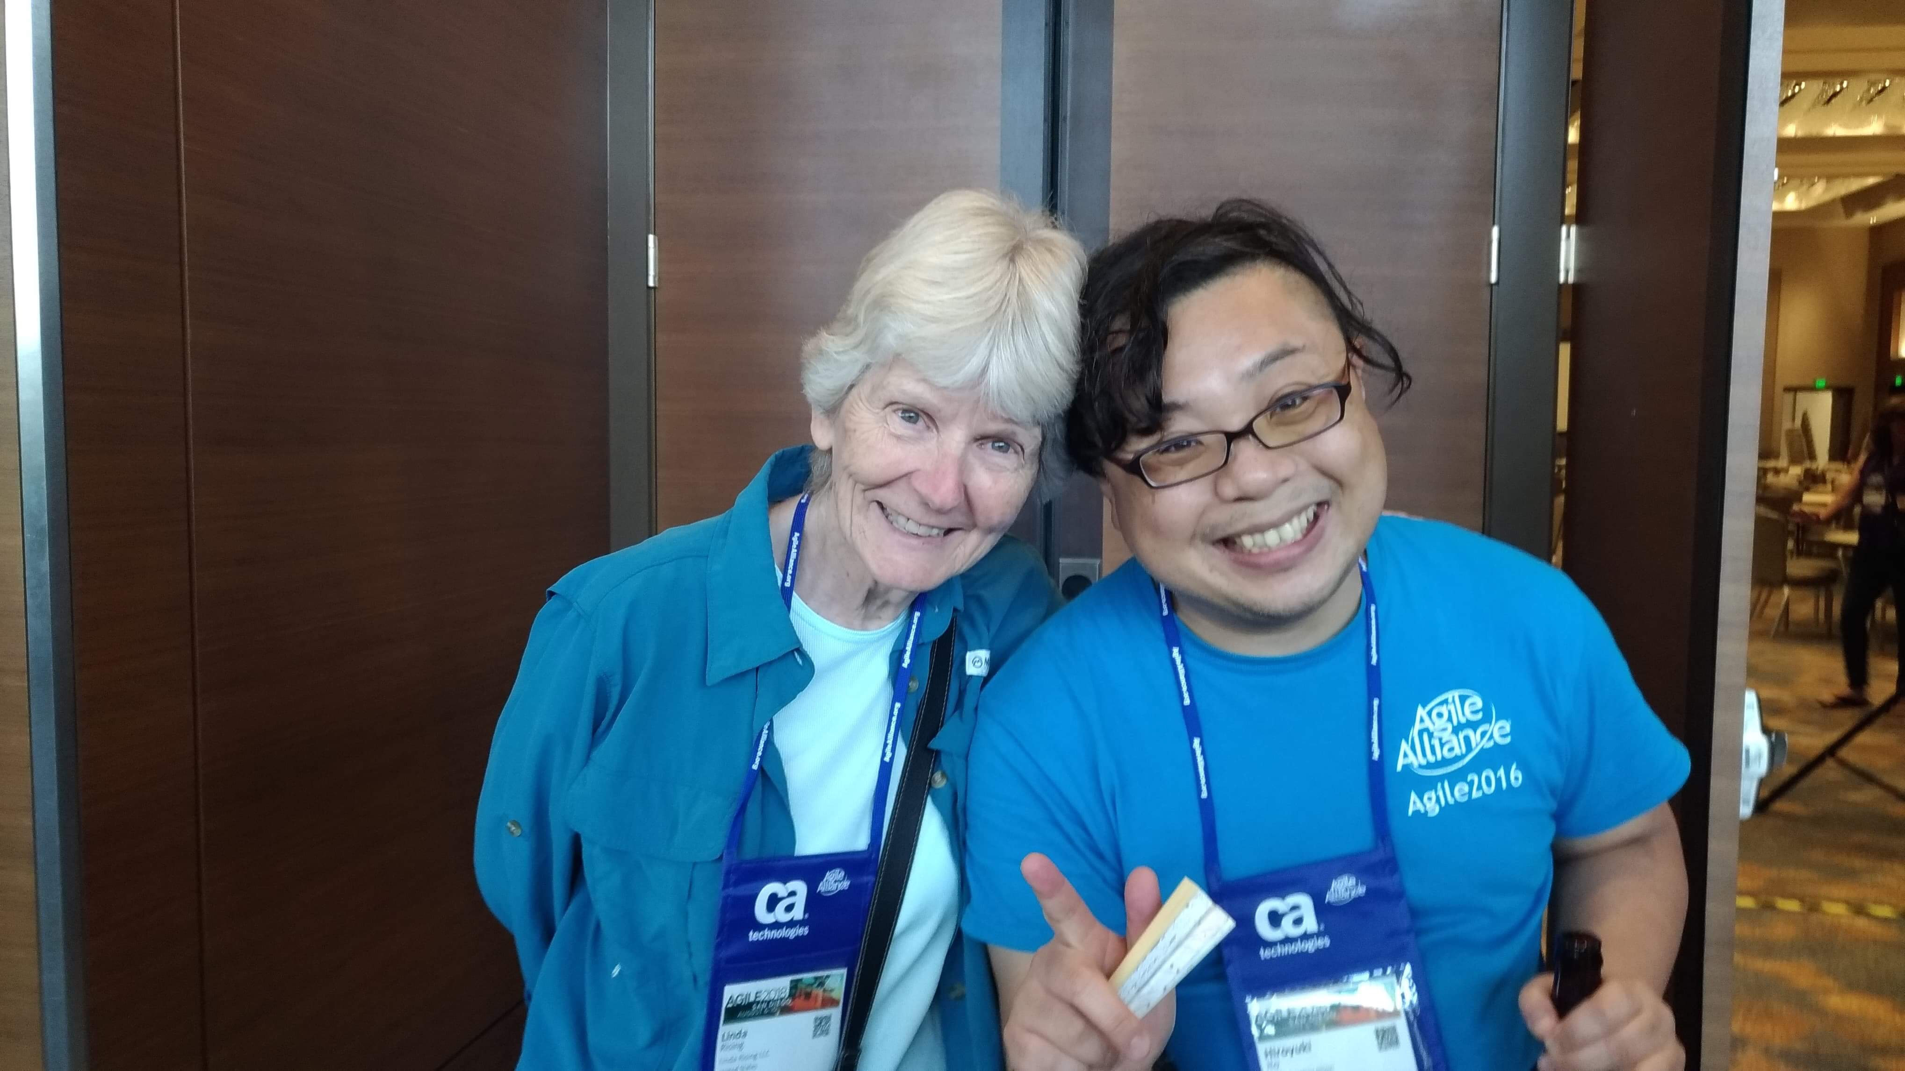
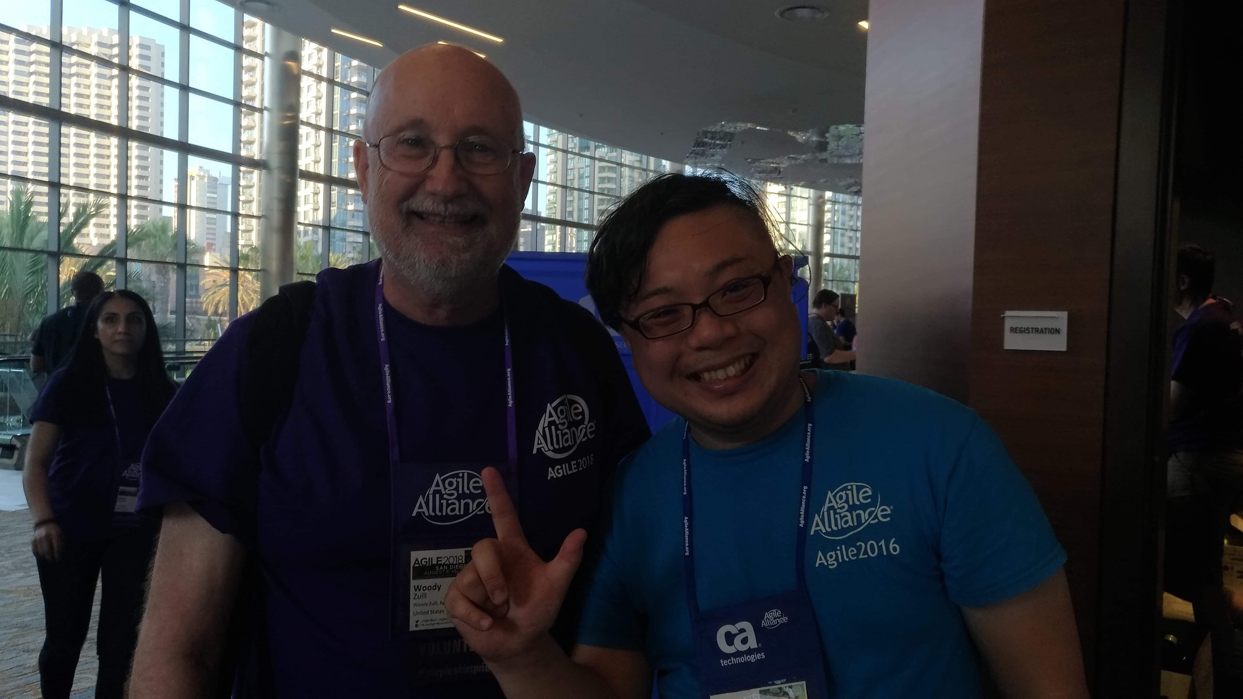
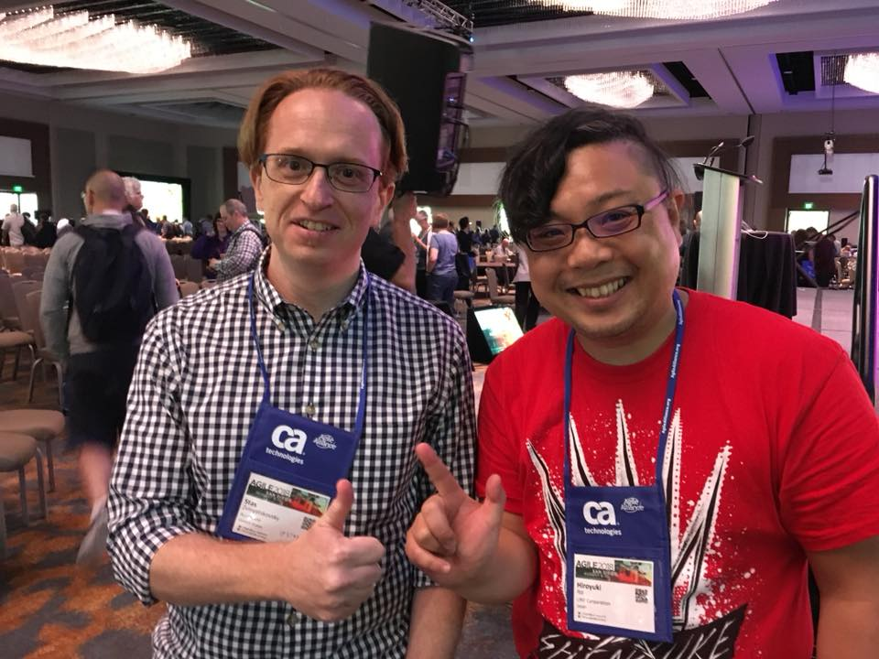
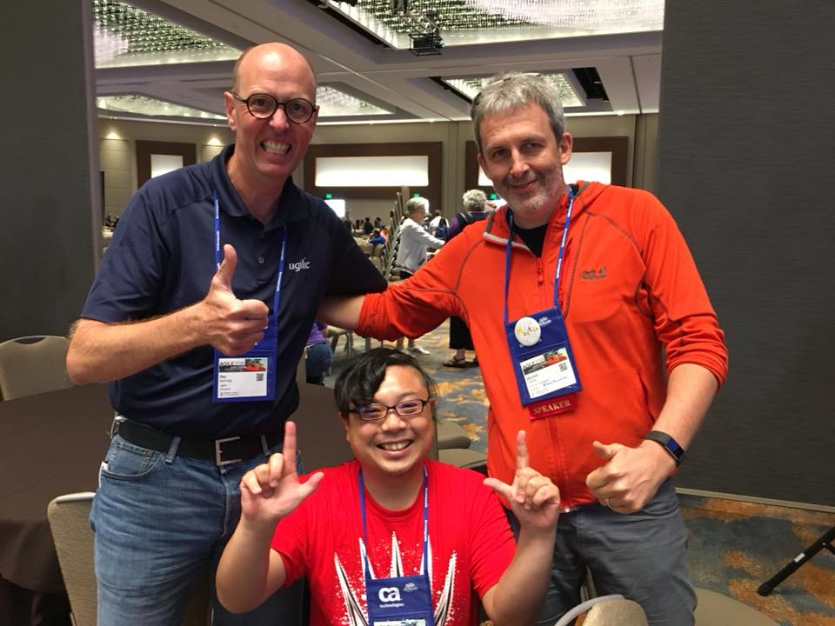
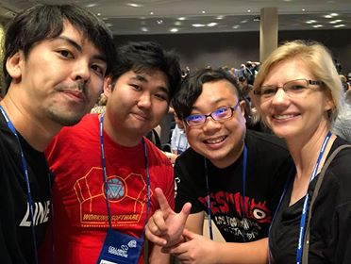
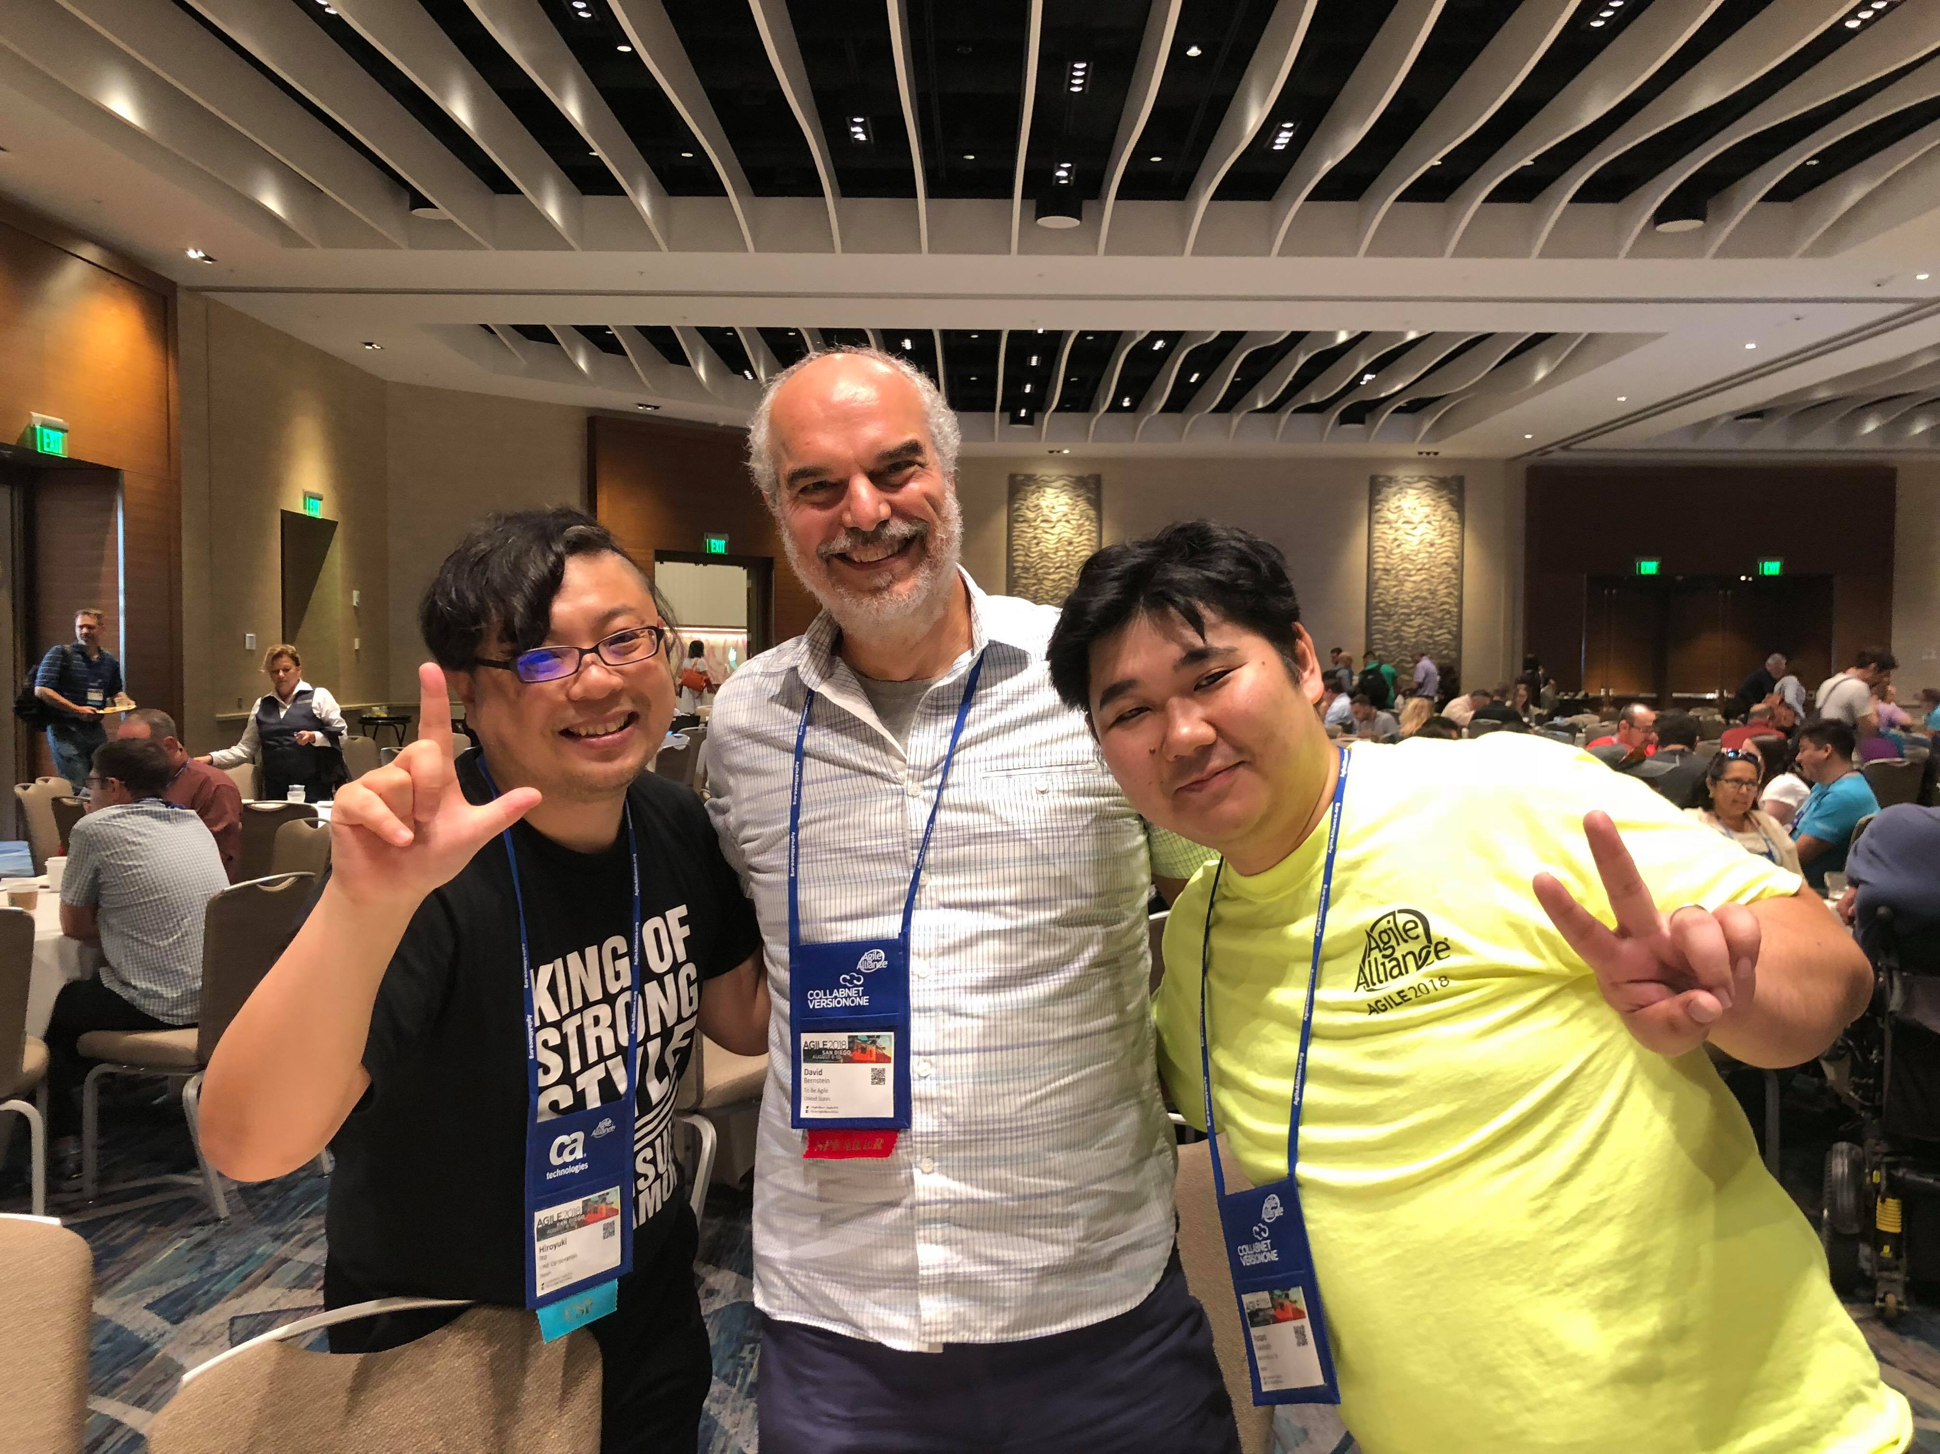
With Global Practitioners!

Slide 5
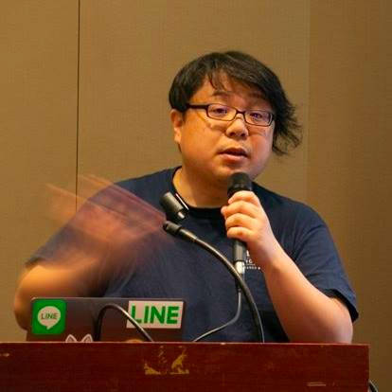


Hiroyuki Ito (The HIRO)
@hageyahhoo
The 1st SET at LINE Corp.
Keynote Speaker of DevOps Summit 2016 (TW)
Speaker of Agile2014

Slide 6
$ history
6 times attendee from Japan!
[Reports]
Agile2017 (JP)
Agile2016 (JP)
Agile2014 (EN)
Agile2013 (JP)
Agile2012 (JP)

Slide 7
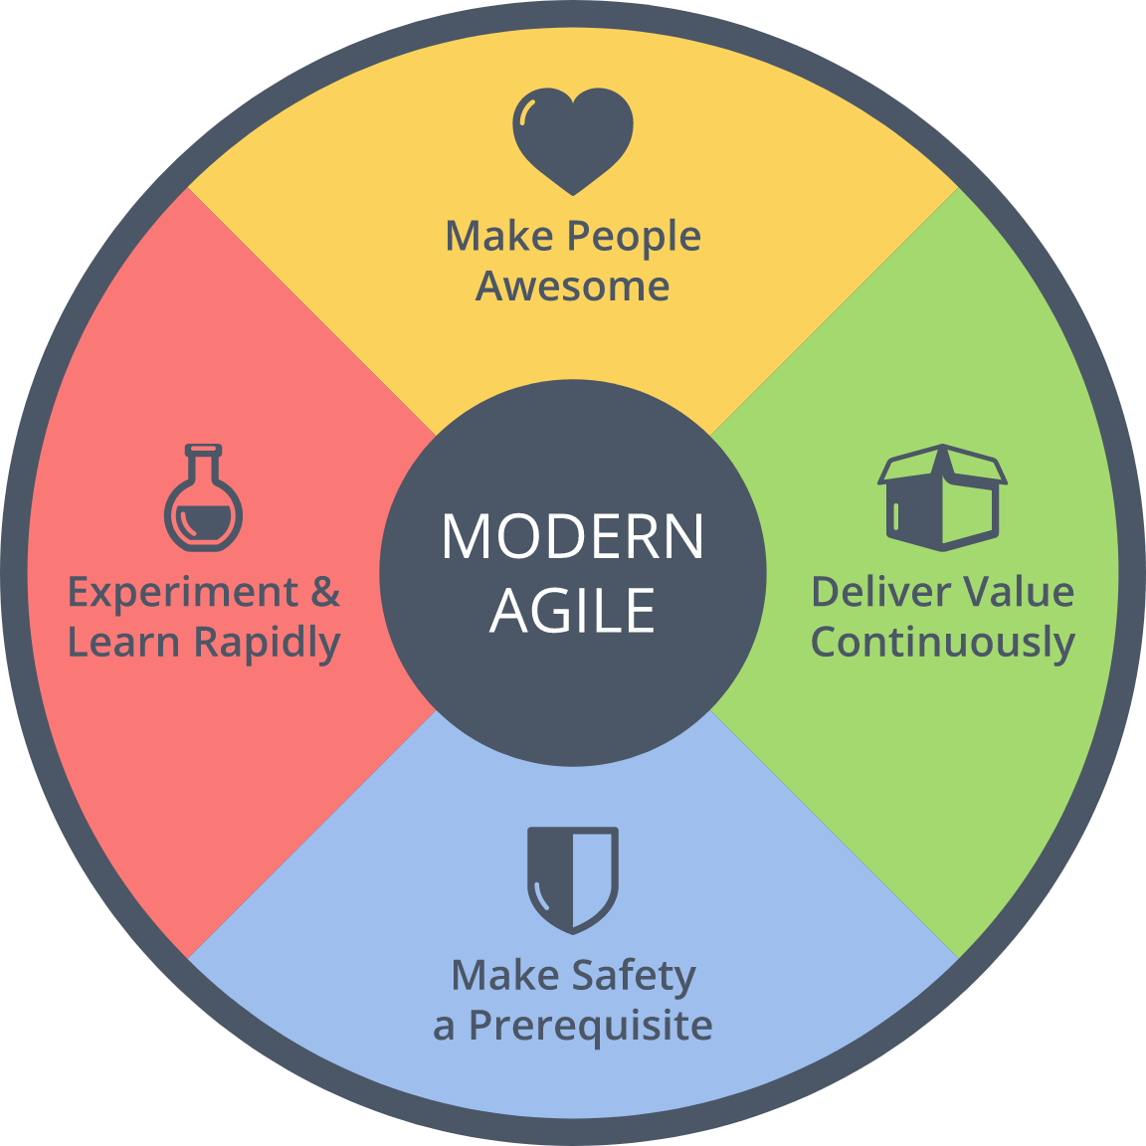
$ history
Achievements
2016 : Brought back
2014 : Speaker
Brought back Metrics
2013 : Speech at OpenJam

Slide 8
Agenda
1. Summary of Agile2018
2. Three Big Trends
3. Focus More on Outcome
4. Other Topics
5. Conclusion

Slide 9
1. Summary of Agile2018
2. Three Big Trends
3. Focus More on Outcome
4. Other Topics
5. Conclusion

Slide 10

What is Agile2018?
https://www.agilealliance.org/agile2018/
Annual global conference of Agile in USA
The biggest one of Agile
Held by Agile Alliance

Slide 11
Basic Information
Duration | Aug. 6th – 10th (5 days)
# of Sessions | 279 (+5 YoY)
# of Categories | 21 (±0 YOY)
# of Parallel On-going Sessions | 20 (+1 YoY)
# of Attendees | 2,500
Type of Sessions | Talk/Workshop
Level of Sessions | Learning/Practicing/ Advancing

Slide 12
Categories (2018)
Category | # | Category | #
Agile Companies | 16 | Keynotes | 3
Agile Data Metrics and Forecasting | 6 | Leadership | 21
Agile Foundations | 7 | Learning | 19
Agile Midway | 7 | Project Program & Portfolio Management | 18
Coaching & Mentoring | 21 | Testing & Quality | 12
Collaboration Culture & Teams | 24 | User Experience | 12
Customers & Products | 15 | Experience Reports | 24
Dev Practices and Craft | 17 | The Future of Agile Software Development (IEEE Software) | 8
DevOps | 12 | Audacious Salon | 14
Enterprise Agile | 20 | Stalwarts | 10

Slide 13
Categories (2018)
Category | # | Category | #
Agile Companies | 16 | Keynotes | 3
Agile Data Metrics and Forecasting | 6 | Leadership | 21
Agile Foundations | 7 | Learning | 19
Agile Midway | 7 | Project Program & Portfolio Management | 18
Coaching & Mentoring | 21 | Testing & Quality | 12
Collaboration Culture & Teams | 24 | User Experience | 12
Customers & Products | 15 | Experience Reports | 24
Dev Practices and Craft | 17 | The Future of Agile Software Development (IEEE Software) | 8
DevOps | 12 | Audacious Salon | 14
Enterprise Agile | 20 | Stalwarts | 10
Promoted as one category!

Slide 14
Categories (2018)
Category | # | Category | #
Agile Companies | 16 | Keynotes | 3
Agile Data Metrics and Forecasting | 6 | Leadership | 21
Agile Foundations | 7 | Learning | 19
Agile Midway | 7 | Project Program & Portfolio Management | 18
Coaching & Mentoring | 21 | Testing & Quality | 12
Collaboration Culture & Teams | 24 | User Experience | 12
Customers & Products | 15 | Experience Reports | 24
Dev Practices and Craft | 17 | The Future of Agile Software Development (IEEE Software) | 8
DevOps | 12 | Audacious Salon | 14
Enterprise Agile | 20 | Stalwarts | 10
Promoted as one category!
Decreasing. Maybe moved to deliver:Agile 2018

Slide 15
[FYI] Categories (2017)
Category | # | Category | #
Agile Alliance Lounge | 16 | Leadership | 21
Agile Companies | 13 | Learning | 17
Agile Foundations | 7 | Project Program & Portfolio Management | 21
Coaching & Mentoring | 17 | Testing & Quality | 12
Collaboration Culture & Teams | 24 | User Experience | 10
Customers & Products | 15 | Experience Reports | 24
Development Practices & Craftsmanship | 24 | The Future of Agile Software Development (IEEE Software) | 8
DevOps | 16 | Audacious Salon | 14
Enterprise Agile | 25 | Open Jam | 6
Keynotes | 3 | Stalwarts | 11

Slide 16
1. Summary of Agile2018
2. Three Big Trends
3. Focus More on Outcome
4. Other Topics
5. Conclusion

Slide 17
3 Big Trends
Business Agility
Scaling Agile
DevOps for ???

Slide 18
My Motivation
Need to LINE Corp.
Engineering
Scaling Agile
Testing

Slide 19
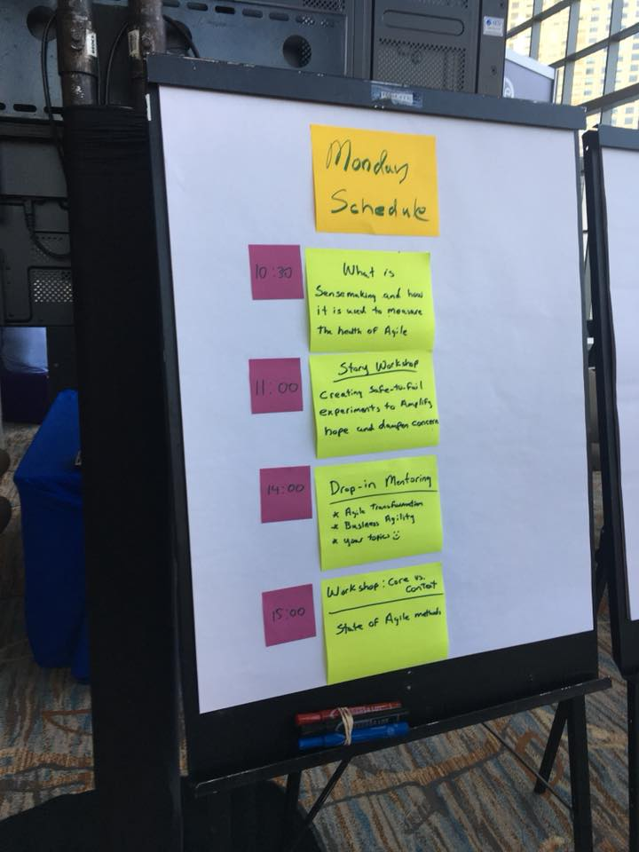
Summary
Beyond IT
Utilize Agile to corporate level
Need to overcome silos

Slide 20
Summary
Beyond IT
Utilize Agile to corporate level
Need to overcome silos

Slide 21
1. Summary of Agile2018
2. Three Big Trends
3. Focus More on Outcome
4. Other Topics
5. Conclusion

Slide 22



解決方針
何らかの （動作する）成果物を 毎週作成・提示する

Slide 23

Making Impacts Constantly
“Managing impact for a team of TEs and SETs is the job of the TEM.”
from How Google Tests Software

Slide 24
Learning to Experiment
aaa

Slide 25
Database DevOps
aaa

Slide 26
1. Summary of Agile2018
2. Three Big Trends
3. Focus More on Outcome
4. Other Topics
5. Conclusion

Slide 27
Radical Change for Testers
aaa

Slide 28
自動テスト＝心理的安全性
（参考）Modern Agile
ここ！

Slide 29
1. Summary of Agile2018
2. Three Big Trends
3. Focus More on Outcome
4. Other Topics
5. Conclusion

Slide 30
これ
1. Moving toward business clearly
Development -> QA/PDM -> Company-wide
2. Utilize technologies for
outcome/value
tools for trial & error
3. Scaling?

Slide 31
Summary
Technology
+
Process
=
Improve Business

